Slide 1
BOOSTING ALGORITHM

Slide 2
What is boosting algorithm?
Boosting is a powerful ensemble machine learning technique that combines multiple weak learners (simple models that perform only slightly better than random guessing) into a single strong learner to maximize predictive accuracy.
Unlike parallel methods like Bagging, boosting operates sequentially, meaning each new model is explicitly trained to correct the mistakes made by the models that came before it.

Slide 3
Boosting Algorithm
Sequential learning: each model focuses on correcting previous errors
1
Training Data
Start with the original training dataset.
2
Model 1
The first model learns patterns from the data.
3
Prediction
Model 1 makes its initial predictions.
4
Calculate Errors
Identify the mistakes made by Model 1.
5
Model 2 learns to correct errors
Model 2 focuses more on the previous mistakes.
6
Updated Prediction
Combine the learning from Models 1 and 2.
7
Model 3 corrects remaining errors
Model 3 focuses on errors that still remain.
8
Final Prediction
Combine the models to produce the final prediction.
Core idea: New models learn from the errors made by earlier models.

Slide 4
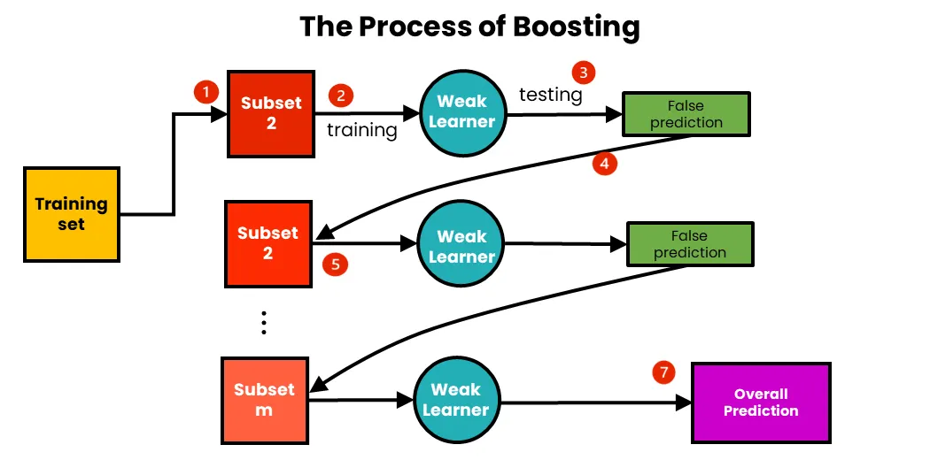

Slide 5
What is AdaBoost algorithm?
AdaBoost, short for Adaptive Boosting, is a powerful ensemble machine learning algorithm that combines multiple weak cl
The core philosophy of AdaBoost is sequential learning: instead of training models independently in parallel (like Random Forests), it trains models one after the other, with each new model specifically designed to correct the mistakes made by the previous ones. assifiers to build a single strong model.

Slide 6
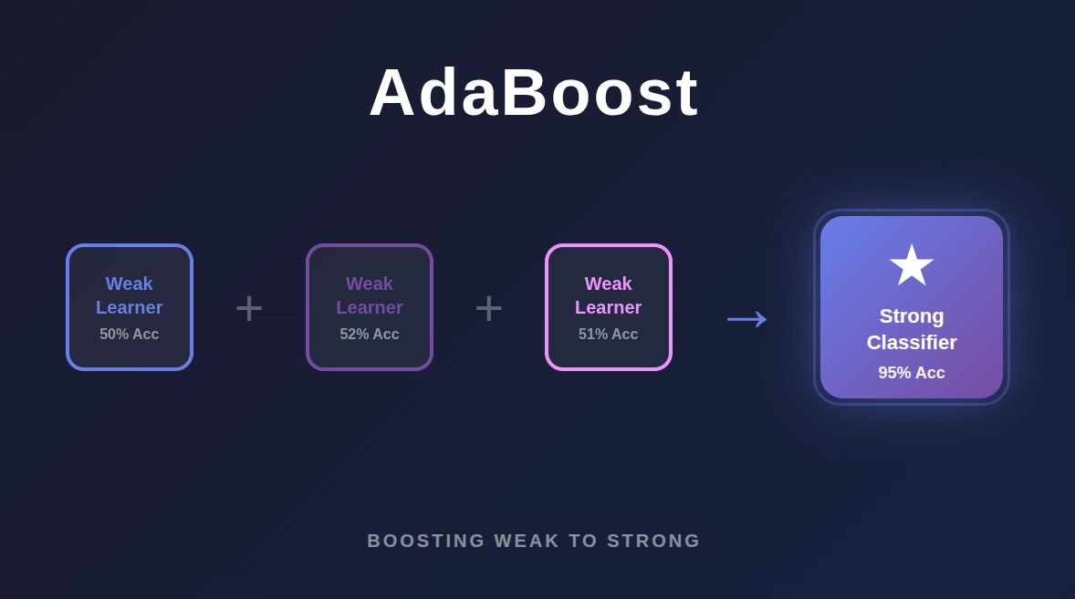

Slide 7
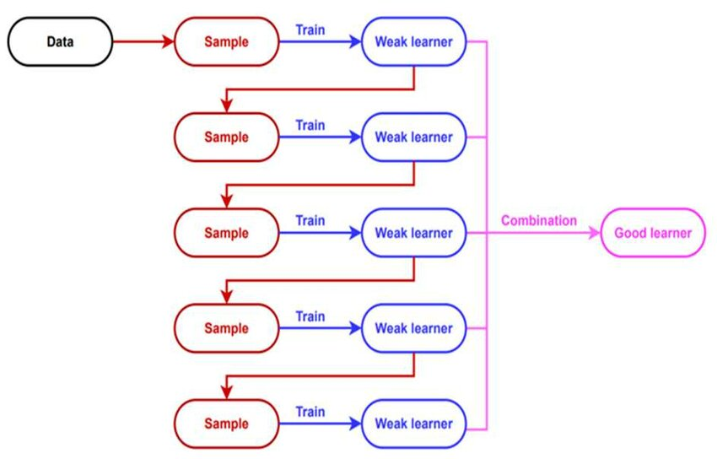
Work Flow

Slide 8
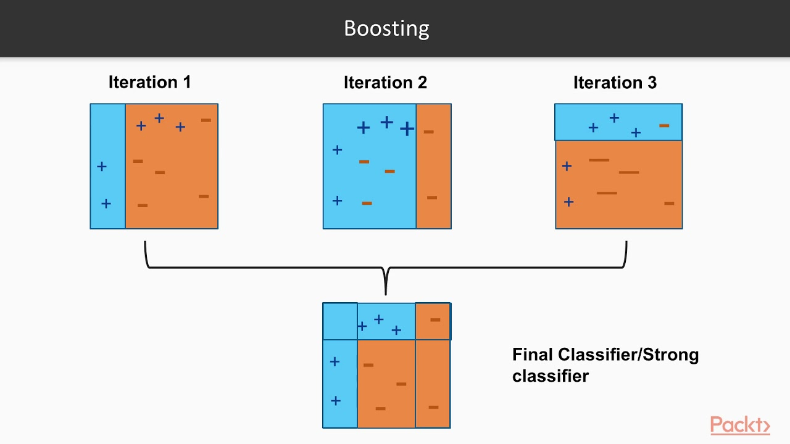
Example

Slide 9
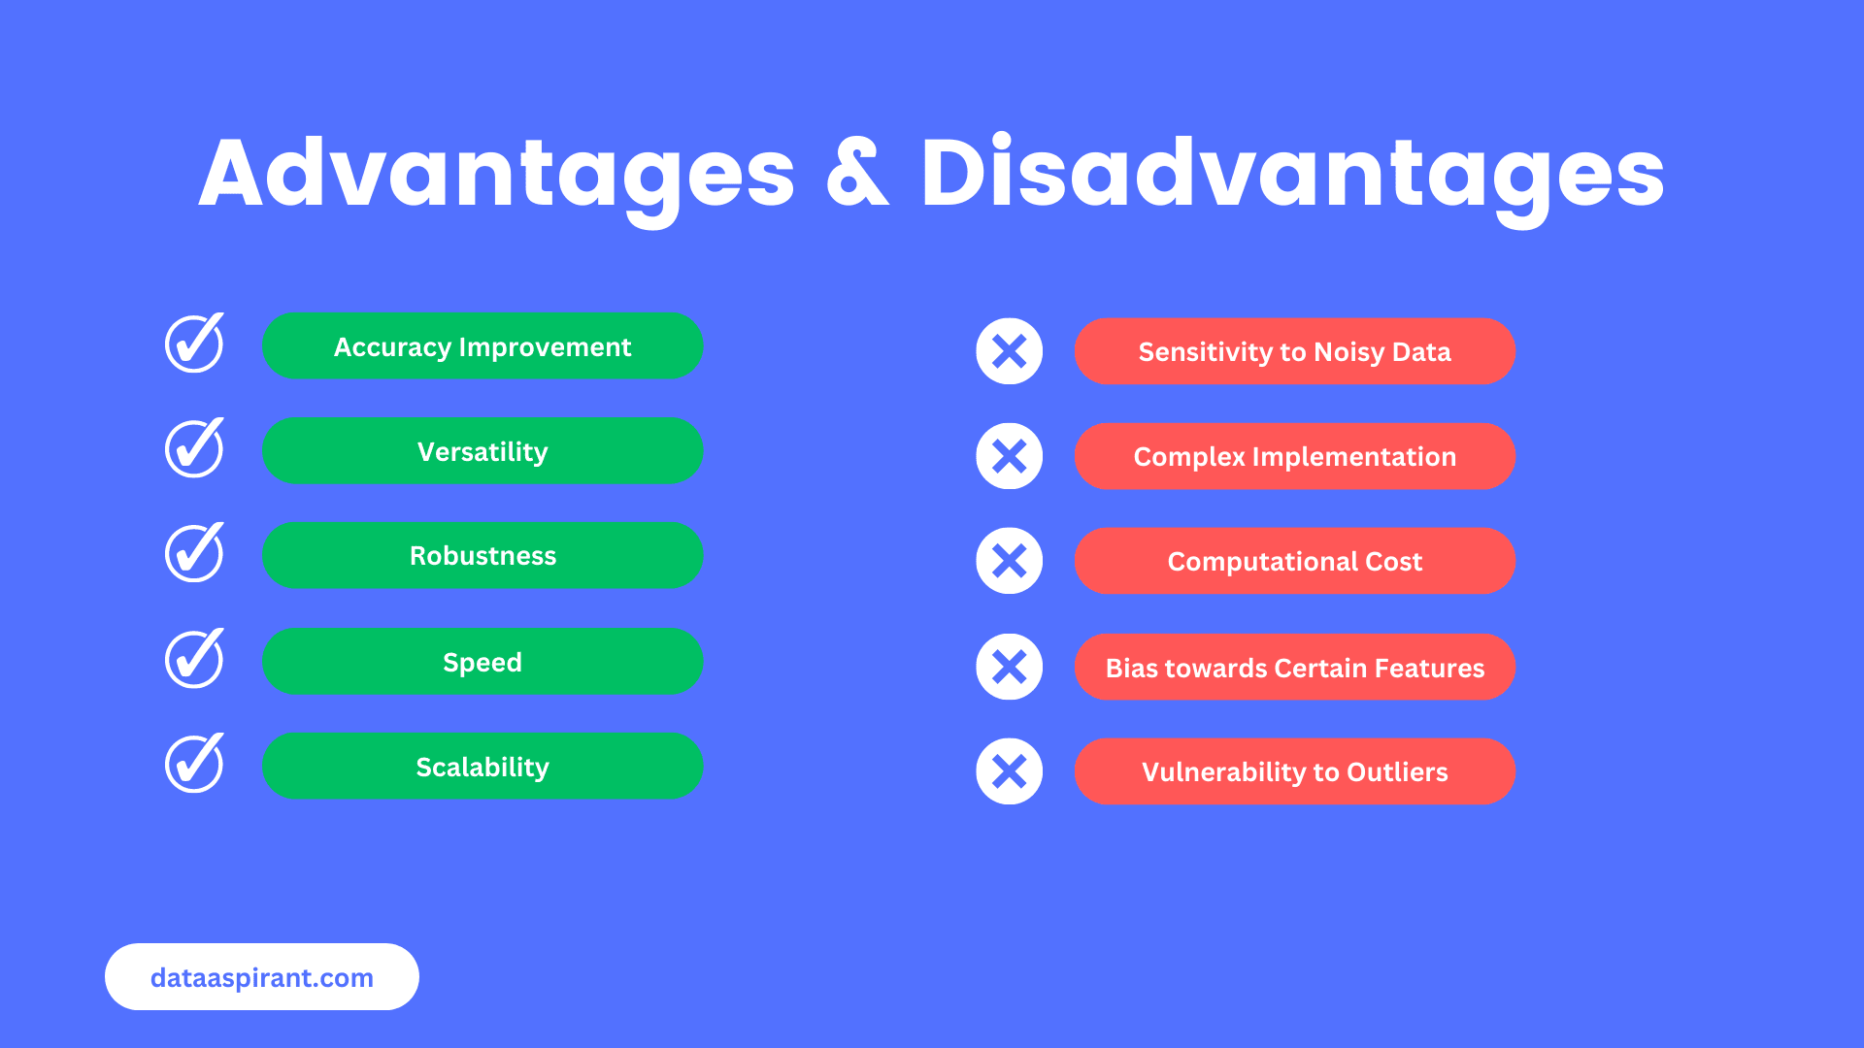

Slide 10
What is XGBoost algorithm?
XGBoost, which stands for eXtreme Gradient Boosting, is a powerful, open-source machine learning library designed for high-performance gradient-boosted decision trees.
XGBoost belongs to a category of machine learning called ensemble learning, which combines the predictions of multiple weak models (in this case, small decision trees) to create one highly accurate "strong" model

Slide 11
Feature | What It Does | Why It Matters
Built-in Regularization | Adds penalties (L1 and L2) to the loss function. | Effectively prevents overfitting, ensuring the model generalizes well to new data.
Parallel Processing | Utilizes all available CPU cores to evaluate features concurrently. | Drastically speeds up training times compared to traditional boosting.
Handling Missing Values | Automatically learns the best default branch split for missing or sparse data. | Eliminates the need for tedious manual data imputation.
Tree Pruning | Uses a parameter (γ) to prune back-split branches that don't meet a minimum information gain threshold. | Keeps trees simple and structurally clean.

Slide 12
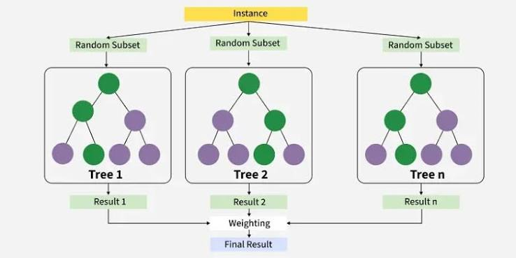

Slide 13
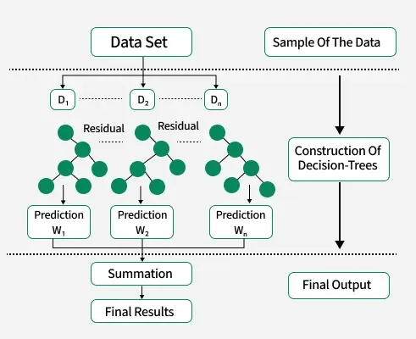

Slide 14
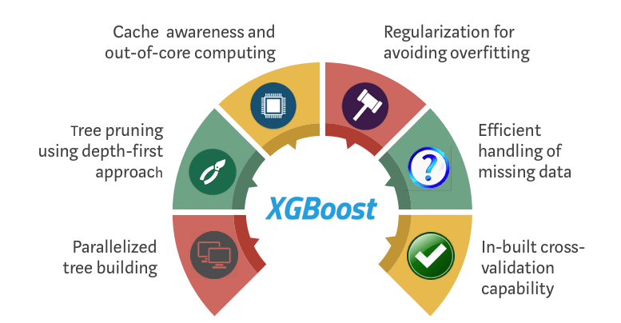

Slide 15
What is LGB algorithm?
LightGBM is a gradient boosting framework that uses tree based learning algorithms. It is designed to be distributed and efficient with the following advantages:
Faster training speed and higher efficiency.
Lower memory usage.
Better accuracy.
Support of parallel, distributed, and GPU learning.
Capable of handling large-scale data.

Slide 16
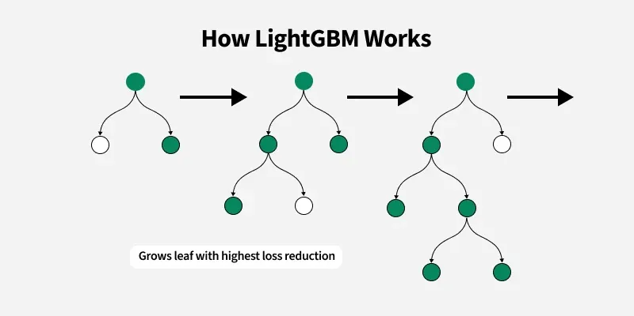

Slide 17
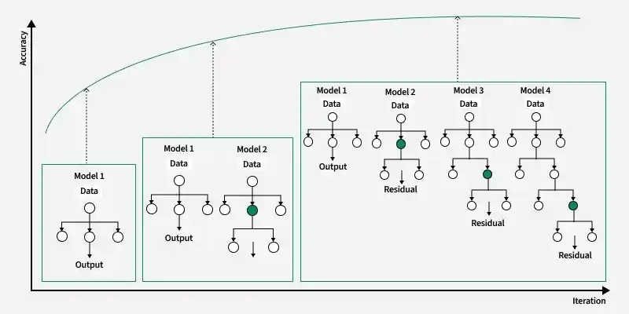

Slide 18
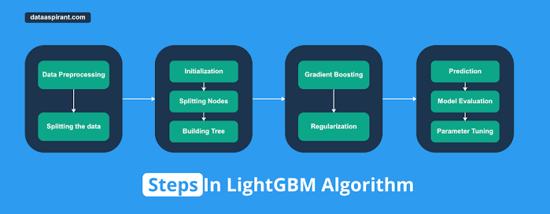

Slide 19
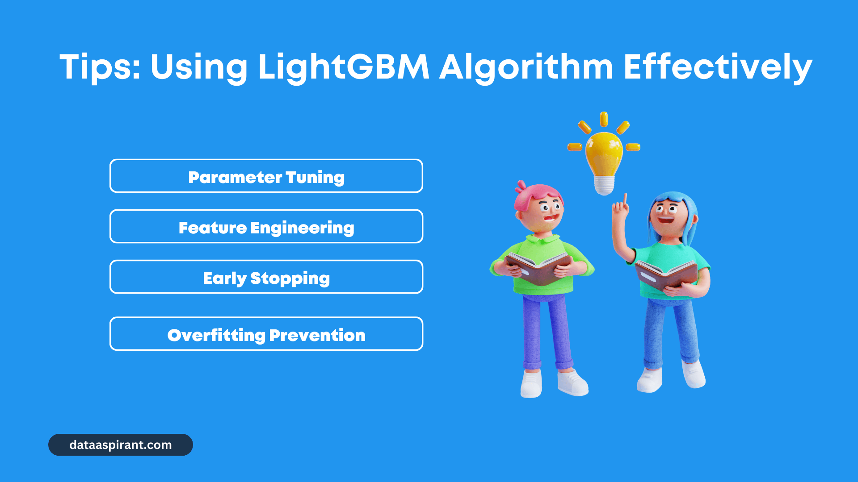

Slide 20
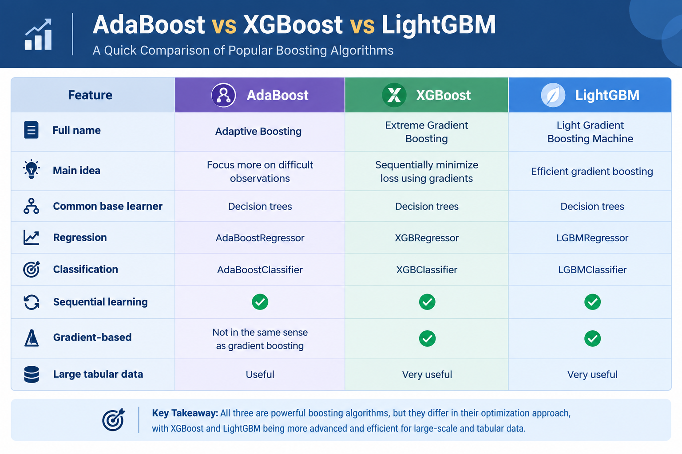

Slide 21
